Slide 1
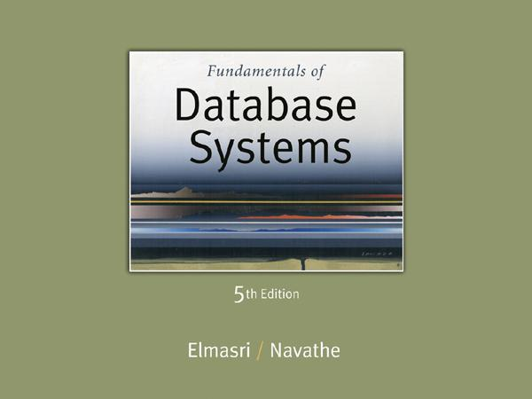
Slide 6- 1
Notes:
1

Slide 2
Chapter Outline
Relational Algebra
Unary Relational Operations
Relational Algebra Operations From Set Theory
Binary Relational Operations
Additional Relational Operations
Examples of Queries in Relational Algebra
Relational Calculus
Tuple Relational Calculus
Domain Relational Calculus
Example Database Application (COMPANY)
Overview of the QBE language (appendix D)
Slide 6- 2
Notes:
2

Slide 3


Example: Department X Employee
Dname | Dnumber | Mgr_ssn | Fname | Lname | Ssn
Research | 5 | 333445555 | John | Smith | 123456789
Research | 5 | 333445555 | Franklin | Wong | 333344555
Administration | 4 | 987565757 | John | Smith | 123456789
Administration | 4 | 987565757 | Franklin | Wong | 333344555

Slide 4
Binary Relational Operations: JOIN (cont.)
Example: Suppose that we want to retrieve the name of the manager of each department.
To get the manager’s name, we need to combine each DEPARTMENT tuple with the EMPLOYEE tuple whose SSN value matches the MGRSSN value in the department tuple.
We do this by using the join operation.
DEPT_MGR ← DEPARTMENT _{MGRSSN=SSN} EMPLOYEE
MGRSSN=SSN is the join condition
Combines each department record with the employee who manages the department
The join condition can also be specified as DEPARTMENT.MGRSSN= EMPLOYEE.SSN
Slide 6- 4
Notes:
4

Slide 5
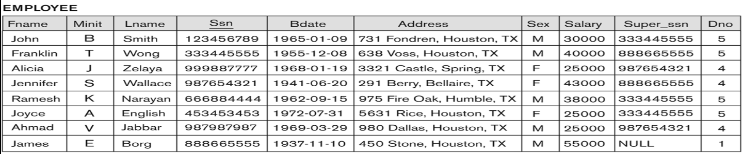
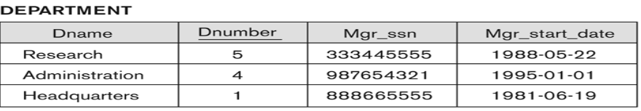
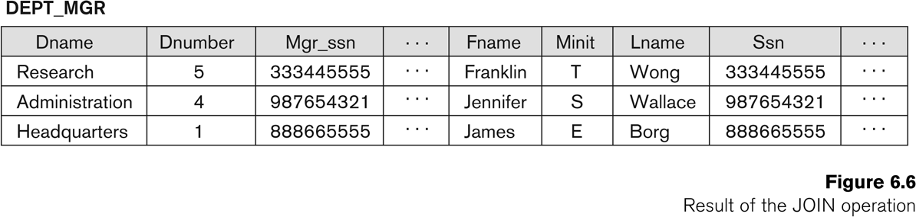
Example of applying the JOIN operation
Slide 6- 5
Notes:
5

Slide 6
Some properties of JOIN
Consider the following JOIN operation:
R(A1, A2, . . ., An) S(B1, B2, . . ., Bm)
R.Ai=S.Bj
Result is a relation Q with degree n + m attributes:
Q(A1, A2, . . ., An, B1, B2, . . ., Bm), in that order.
The resulting relation state has one tuple for each combination of tuples—r from R and s from S, but only if they satisfy the join condition r[Ai]=s[Bj]
Hence, if R has n_{R} tuples, and S has n_{S} tuples, then the join result will generally have less than n_{R} * n_{S} tuples.
Only related tuples (based on the join condition) will appear in the result
Slide 6- 6
Notes:
6

Slide 7
Some properties of JOIN (variations in JOIN)
The general case of JOIN operation is called a Theta-join: R S
theta
The join condition is called theta
Theta can be any general boolean expression on the attributes of R and S; for example:
R.Ai<S.Bj AND (R.Ak=S.Bl OR R.Ap<S.Bq)
Most join conditions involve one or more equality conditions “AND”ed together; for example:
R.Ai=S.Bj AND R.Ak=S.Bl AND R.Ap=S.Bq
Slide 6- 7
Notes:
7

Slide 8
Theta JOIN
The general case of JOIN operation is called a Theta-join: R S
theta
The join condition is called theta
Theta can be any general boolean expression on the attributes of R and S; for example:
R.Ai<S.Bj AND (R.Ak=S.Bl OR R.Ap<S.Bq)
Most join conditions involve one or more equality conditions “AND”ed together; for example:
R.Ai=S.Bj AND R.Ak=S.Bl AND R.Ap=S.Bq
Slide 6- 8
Notes:
8

Slide 9
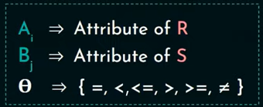


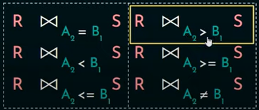
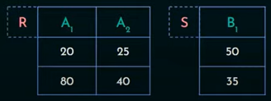

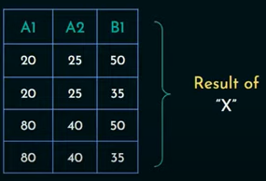

Example

Slide 10
Binary Relational Operations: EQUIJOIN
EQUIJOIN Operation
The most common use of join involves join conditions with equality comparisons only
Such a join, where the only comparison operator used is =, is called an EQUIJOIN.
DEPT_MGR ← DEPARTMENT _{MGRSSN=SSN} EMPLOYEE
Slide 6- 10
Notes:
10

Slide 11
Binary Relational Operations: NATURAL JOIN Operation
NATURAL JOIN Operation
Another variation of JOIN called NATURAL JOIN — denoted by * — was created to get rid of the second (superfluous) attribute in an EQUIJOIN condition.
The standard definition of natural join requires that the two join attributes, or each pair of corresponding join attributes, have the same name in both relations
If this is not the case, a renaming operation is applied first.
Slide 6- 11
Notes:
11

Slide 12
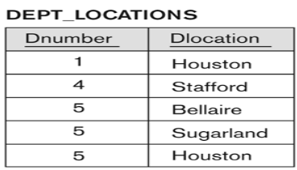
Binary Relational Operations NATURAL JOIN (contd.)
Example: To apply a natural join on the DNUMBER attributes of DEPARTMENT and DEPT_LOCATIONS, it is sufficient to write:
DEPT_LOCS ← DEPARTMENT * DEPT_LOCATIONS
Only attribute with the same name is DNUMBER
An implicit join condition is created based on this attribute:
DEPARTMENT.DNUMBER=DEPT_LOCATIONS.DNUMBER
Slide 6- 12
Notes:
12

Slide 13




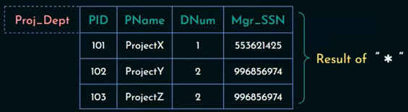
Binary Relational Operations NATURAL JOIN (contd.)
Example:
Slide 6- 13
Notes:
13

Slide 14
Additional Relational Operations
The OUTER JOIN Operation
In NATURAL JOIN and EQUIJOIN, tuples without a matching (or related) tuple are eliminated from the join result
Tuples with null in the join attributes are also eliminated
This amounts to loss of information.
A set of operations, called OUTER joins, can be used when we want to keep all the tuples in R, or all those in S, or all those in both relations in the result of the join, regardless of whether or not they have matching tuples in the other relation.
Slide 6- 14
Notes:
14

Slide 15
Outer joins include tuples even if they do not have a matching counterpart.
Left Outer Join (⟕): Includes all tuples from the left relation.
Right Outer Join (⟖): Includes all tuples from the right relation.
Full Outer Join (⟗): Includes all tuples from both relations.

Slide 16
Example :Left outer join
If Department has a Dept_ID = 3 ("Finance"), but no employees belong to it, a left outer join:
Employee (E)
Department (D)
Emp_ID | Name | Dept_ID
101 | Alice | 1
102 | Bob | 2
103 | Carol | 1
Dept_ID | Dept_Name
1 | HR
2 | IT
E⟕D
Emp_ID | Name | Dept_ID | Dept_Name
101 | Alice | 1 | HR
102 | Bob | 2 | IT
103 | Carol | 1 | HR
NULL | NULL | 3 | Finance

Slide 17
Right Outer Join (E ⟖ D)
Emp_ID | Name | Dept_ID | Dept_Name
101 | Alice | 1 | HR
103 | Carol | 1 | HR
102 | Bob | 2 | IT
NULL | NULL | 3 | Finance
The last row represents Dept_ID = 3 ("Finance"), which has no employees,
So Emp_ID and Name are NULL.

Slide 18
Full Outer Join (E ⟗ D)
A Full Outer Join retrieves all tuples from both Employee (E) and Department (D), including unmatched records from both sides.
The output is the same as Right Outer Join in this case since all employees belong to a department.
If there was an employee without a department, it would also be included with a NULL Dept_Name.
Emp_ID | Name | Dept_ID | Dept_Name
101 | Alice | 1 | HR
103 | Carol | 1 | HR
102 | Bob | 2 | IT
NULL | NULL | 3 | Finance

Slide 19
Binary Relational Operations: DIVISION
DIVISION Operation
The division operation is applied to two relations R and S
R(Z) ÷ S(X), where X is subset of Z.
The division operator is used for queries which involve the 'all'.
R1 ÷ R2 = tuples of R1 associated with all tuples of R2.
Example
Retrieve the name of the subject that is taught in all courses.
Slide 6- 19
Notes:
19

Slide 20
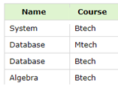



Slide 21
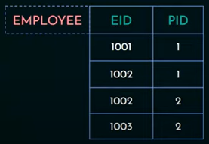


To retrieve the Employee ID(EID) of all employees works on all projects.

Slide 22
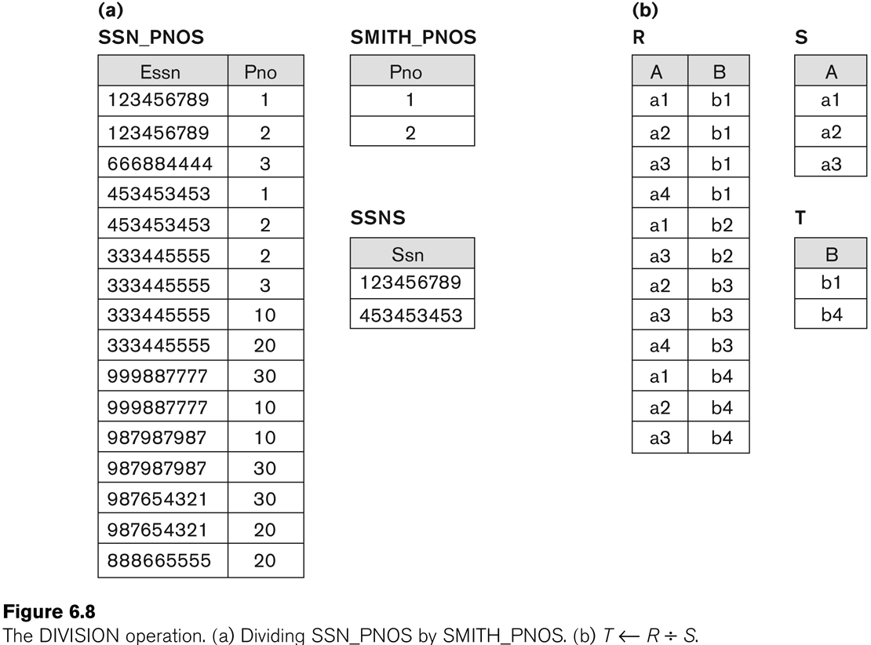
Example of DIVISION
Slide 6- 22
Notes:
22

Slide 23
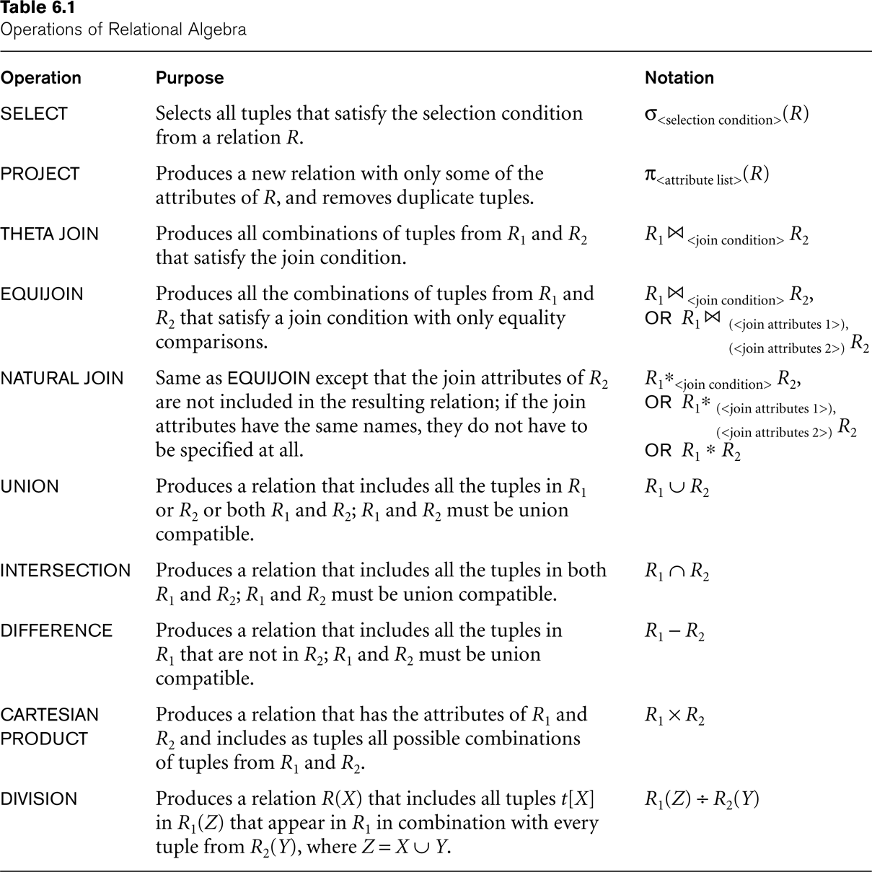
Recap of Relational Algebra Operations
Slide 6- 23
Notes:
23

Slide 24
Additional Relational Operations: Aggregate Functions and Grouping
A type of request that cannot be expressed in the basic relational algebra is to specify mathematical aggregate functions on collections of values from the database.
Examples of such functions include retrieving the average or total salary of all employees or the total number of employee tuples.
These functions are used in simple statistical queries that summarize information from the database tuples.
Common functions applied to collections of numeric values include
SUM, AVERAGE, MAXIMUM, and MINIMUM.
The COUNT function is used for counting tuples or values.
Slide 6- 24
Notes:
24

Slide 25
Aggregate Function Operation
Use of the Aggregate Functional operation ℱ
ℱ_{MAX Salary} (EMPLOYEE) retrieves the maximum salary value from the EMPLOYEE relation
ℱ_{MIN Salary} (EMPLOYEE) retrieves the minimum Salary value from the EMPLOYEE relation
ℱ_{SUM Salary} (EMPLOYEE) retrieves the sum of the Salary from the EMPLOYEE relation
ℱ_{COUNT SSN, AVERAGE Salary} (EMPLOYEE) computes the count (number) of employees and their average salary
Note: count just counts the number of rows, without removing duplicates
Slide 6- 25
Notes:
25

Slide 26
Using Grouping with Aggregation
The previous examples all summarized one or more attributes for a set of tuples
Maximum Salary or Count (number of) Ssn
Grouping can be combined with Aggregate Functions
Example:
For each department, retrieve the DNO, COUNT SSN, and AVERAGE SALARY
A variation of aggregate operation ℱ allows this:
Grouping attribute placed to left of symbol
Aggregate functions to right of symbol
_{DNO} ℱ_{COUNT SSN, AVERAGE Salary} (EMPLOYEE)
Above operation groups employees by DNO (department number) and computes the count of employees and average salary per department
Slide 6- 26
Notes:
26

Slide 27
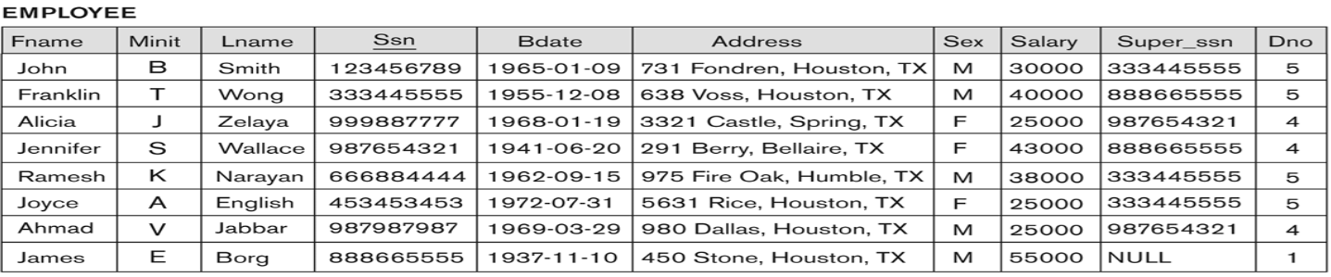

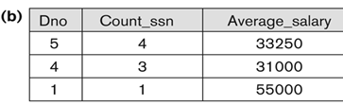
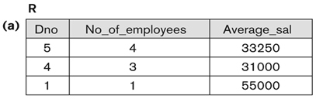
Examples of applying aggregate functions and grouping
Slide 6- 27
Notes:
27

Slide 28
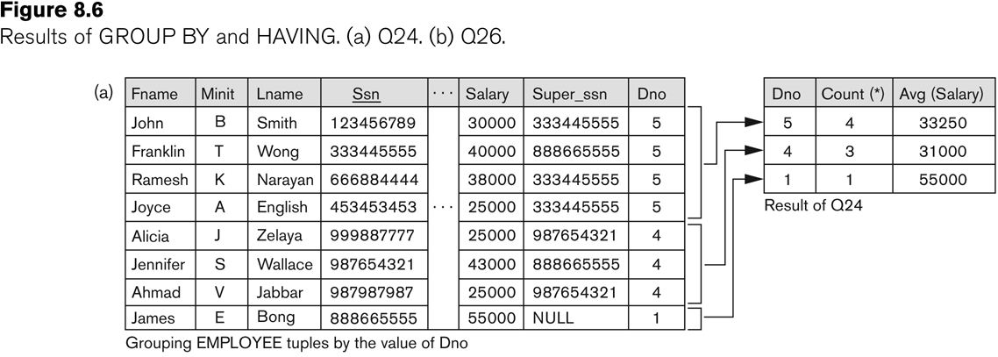
Illustrating aggregate functions and grouping
Slide 6- 28
Notes:
28

Slide 29
Examples of Queries in Relational Algebra
Q1: Retrieve the name and address of all employees who work for the ‘Research’ department.
RESEARCH_DEPT ← σ DNAME=’Research’ (DEPARTMENT)
RESEARCH_EMPS ← (RESEARCH_DEPT _{DNUMBER= DNOEMPLOYEE}EMPLOYEE)
RESULT ← π FNAME, LNAME, ADDRESS (RESEARCH_EMPS)
Q6: Retrieve the names of employees who have no dependents.
ALL_EMPS ← π SSN(EMPLOYEE)
EMPS_WITH_DEPS(SSN) ← π ESSN(DEPENDENT)
EMPS_WITHOUT_DEPS ← (ALL_EMPS - EMPS_WITH_DEPS)
RESULT ← π LNAME, FNAME (EMPS_WITHOUT_DEPS * EMPLOYEE)
Slide 6- 29
Notes:
29

Slide 30
Relational Calculus
Relational calculus is a non-procedural query language in Relational Database Management Systems (RDBMS) that focuses on what to retrieve rather than how to retrieve it.
Unlike relational algebra, which provides step-by-step operations to get the result, relational calculus describes the desired result using logical expressions.
Types of Relational Calculus
Tuple Relational Calculus (TRC)
Domain Relational Calculus (DRC)

Slide 31
Tuple Relational Calculus (TRC)
Uses tuples (rows) as variables.
Expresses queries in the form of predicate logic.
Syntax:{𝑡 ∣ 𝑃(𝑡)}
t represents a tuple variable.
P(t) is a logical condition (predicate).
The result includes all tuples t that satisfy 𝑃(𝑡).

Slide 32
Example of TRC
Find names of employees working in the "HR" department.
{𝑡.𝑁𝑎𝑚𝑒 ∣ 𝑡∈𝐸𝑚𝑝𝑙𝑜𝑦𝑒𝑒 ∧ ∃𝑑∈𝐷𝑒𝑝𝑎𝑟𝑡𝑚𝑒𝑛𝑡 (𝑡.𝐷𝑒𝑝𝑡_𝐼𝐷=𝑑.𝐷𝑒𝑝𝑡_𝐼𝐷 ∧ 𝑑.𝐷𝑒𝑝𝑡_𝑁𝑎𝑚𝑒=′𝐻𝑅′)}
t is a tuple from the Employee relation.
The condition ensures that 𝑡.𝐷𝑒𝑝𝑡_𝐼𝐷 matches a department with name "HR".
The result includes only employee names who satisfy this condition.

Slide 33
Example
Consider the Student table:
To retrieve students from the CS department, the TRC query is:
{t ∣ t ∈ Student ∧ t.Department=′CS′}
RollNo | Name | Age | Department
101 | John | 21 | CS
102 | Alice | 22 | IT
103 | Bob | 20 | CS
104 | Eve | 23 | ECE
RollNo | Name | Age | Department
101 | John | 21 | CS
103 | Bob | 20 | CS
Result:

Slide 34
Domain Relational Calculus (DRC)
Uses domain values (attribute values) instead of tuples.
Expresses queries using logical conditions on attribute values.
Syntax:
{<𝑑1,𝑑2,...,𝑑𝑛> ∣ 𝑃(𝑑1,𝑑2,...,𝑑𝑛)}
𝑑1,𝑑2,...,𝑑𝑛 are domain variables (attribute values).
𝑃(𝑑1,𝑑2,...,𝑑𝑛) is a logical condition.

Slide 35
Example of DRC
To retrieve the RollNo and Name of students in the CS department, the DRC query is:
{<R,N> ∣ ∃A,D (Student(R,N,A,D)∧D=′CS′)}
Uses domain variables instead of tuples.
Extracts the employee name where Dept_Name = 'HR'
Result:
RollNo | Name
101 | John
103 | Bob

Slide 36
Chapter Summary
Relational Algebra
Unary Relational Operations
Relational Algebra Operations From Set Theory
Binary Relational Operations
Additional Relational Operations
Examples of Queries in Relational Algebra
Slide 6- 36
Notes:
36

